Slide 1
Proposed Outline for a Course on Digital Supply Chain Management

Slide 2
Course Outline
Introduction
Digital Supply Networks: An Overview
Managing Digital Transformation
Connected Customer
Digital Development
Intelligent Supply
Synchronized Planning
Smart Operations
Dynamic Fulfillment
Course Conclusion: Visualizing the Future

Slide 3
Introduction
Learning objectives:
  Understand the goals and structure of this course
  Explain the foundational structure of the DSN framework and its differences from the SCOR model
  Gain a sense of the status quo and state-of-the-art in digital supply chains
Core concepts:
  Digitalization (vs digitization)
  DSN, digital thread
Supporting content:
  Surveys on level and rate of adoption
  National productivity statistics

Slide 4
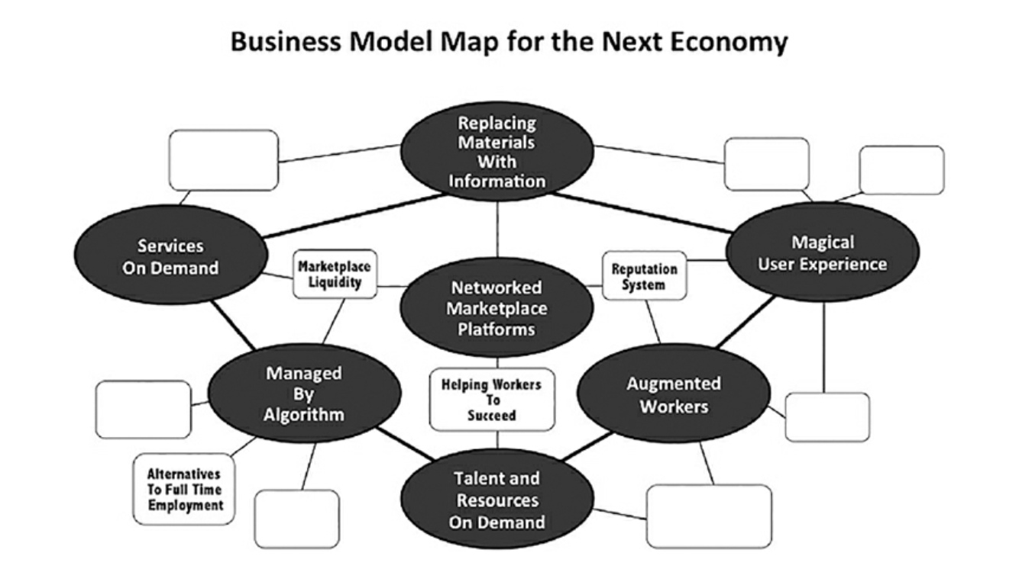
Source: WTF? What’s the Future….ADD HERE

Slide 5
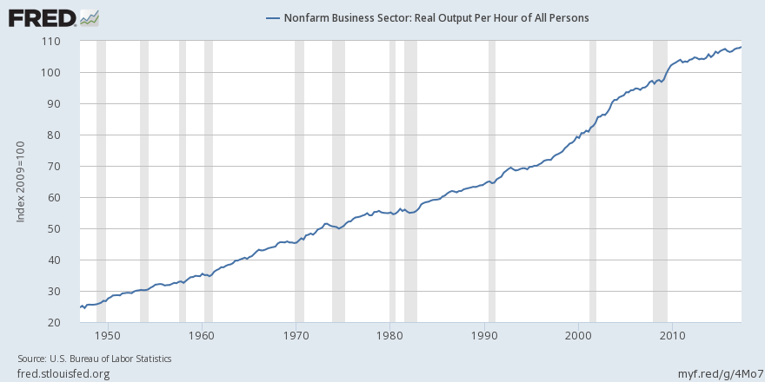
0.8%
2.7%
1.4%
Notes:
Why the productivity slow down?
Limited capital accrual and investment
Increasing regulation
Limited diffusion of innovations. Top firms productivity is great but others lagging (the frontier is moving out but average firms falling behind)
Some of the biggest growers (computers, electronics, petroleum and coal, retail) have showed the biggest slowdowns

Slide 6
Learning Objectives: What Do Students Need to Know about “Digital” Supply Chains?
Understanding of the technology landscape
  Examples of technology solutions
  Organizing framework/Categories of technology
Facility with terminology
Understanding of opportunities, capabilities enabled by digital technologies
Appreciation for scope of change required, implementation challenges, etc.
Knowledge of change management best practices

Slide 7
A “scenario” (next two slides) to stimulate interest and discussion of the “digital supply chain”

Slide 8
The Order
One morning in the not too distant future, you receive a text message at 7:00 a.m. from your toaster oven as it browns your morning slice of cinnamon bread. The text says that a sensor in the oven has detected that one of the heating elements is about to burn out, and given the predicted remaining useful life of the oven’s other components, it would be best to replace the oven now, rather than to repair it.
The text actually came from ODI, your “Online Digital Identity,” which is connected to all your devices. ODI immediately sends you pictures and brief descriptions of 2-3 new toaster oven options and prices. Because ODI has interacted with you for years, observing your toasting habits as well as other aspects of your life, it can select oven styles (size, shape, color) and features (number of heating elements, settings, etc.), that you are likely to find appealing, while also optimizing a value algorithm (benefit/cost). To develop these recommendations, ODI worked with Megazon (an online retailer). It took 15 milliseconds for Megazon’s design engine to receive the design parameters from ODI and respond with recommended configurations.
You can select one of the options, or use a drop down menu to add or change any of the features, with immediate price updates. Megazon provides the prices using its demand planning system, which instantly combines information about you (income, location, reward status, and other demographics) with its own internal operating data (e.g., current delivery capacity, forecast of suppliers’ production utilization levels, etc.). Once you are satisfied with a one-of-a-kind toaster oven design and price, ODI places the order with Megazon, which logs the transaction on a “blockchain” (where it is authenticated and funds are immediately transferred) and then replies with a thank-you message, a receipt (which ODI stores for you), and a notice that the oven will be delivered that afternoon. Meanwhile, you place your old toaster on your front porch for recycling. It’s now 7:05 a.m.

Slide 9
The Response
Megazon immediately sends the toaster oven design out for bid to several vendors that have fulfillment centers located within four hours travel time from your home. Each vendor bids on the job using its own “cost-to-serve” intelligent calculator, which incorporates data on the availability of materials and production capacity both in-house and at suppliers. In less than one second, an auction is completed, a vendor, Printhub.com, is selected, and the order is transmitted.
At one of Printhub’s fulfillment centers (selected based on proximity and current workload), the order is scheduled by the manufacturing execution system (MES), and 3D printers immediately begin printing unique structural parts for the oven, while robots pull and kit the needed standard components from inventory. By 8:30 a.m., a completed kit is conveyed to an assembly area, where robots assemble, pack, and deliver the oven to the shipping area. It is picked up there by Megazon’s delivery service, either by a drone (air or land) or by one of your neighbors who is making a few extra bucks working for SuperLift home delivery. Megazon’s transportation management system (TMS) chooses the delivery mode and timing based on its evaluation of traffic patterns, availability of drone or driver capacity, and cost. The oven is delivered to your doorstep or nearby lockbox, based on your recorded preference, and a text is sent to you at the moment of delivery. The deliverer also picks up your old oven and delivers it to a nearby refurbishment/recycling center, which happens to be located next door to Printhub’s fulfillment center.

Slide 10

Technology Evolution and Business Model Emergence
Smart
Phones
Pricing
Algorithm
GPS
Rating
System
Credit
System
Buyers/Sellers
Critical Mass
User
Interface
Payment
System
Dispatching
Algorithm

Slide 11


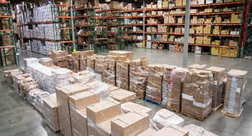
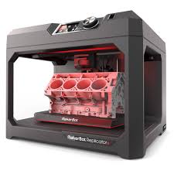



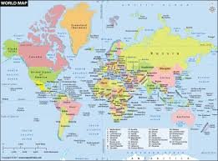

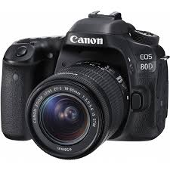
Implications/Predictions: Dematerialized
Material Digital
Inventory Information
To Stock To Order
Ownership Access
Unitary Modular Design Design
Notes:
Changing information media (CD to MP3s, Books to Kindle, newspapers to web sites, documents to electronic files)
Replacing inventory with information
Safety stock: reduced uncertainty
Cycle/seasonal stock: faster/cheaper order process, shorter lead time
Transit stock: 3D printing, automation enables production closer to market (no longer prioritizing low labor cost sources – prioritize market access over supply access)
E-commerce supports centralization: pooling reduces cycle and safety stocks
Customization/On demand
Customized products reduce extraneous functions, parts materials
Customized packaging reduces material waste (e.g., Packsize boxes)
Replacing ownership with access: Uber, AirBnB increase utilization of existing assets
Integrated design
Multi-function products (smart phone replaces phone, camera, GPS, wallet, calendar, flashlight, etc.)
Reduced need for functions: smart car avoids accidents, no longer need material for crumple zones, air bags, etc.
Computational design more precise and efficient: 3D printing, better dimensional design reduces need for material

Slide 12
Dematerialization of Value
Source: Kelly, The Inevitable: …, 2016, p. 111

Slide 13


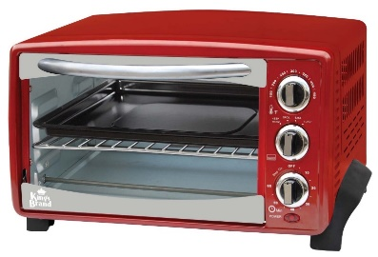


Implications/Predictions: Service Platforms
From product/service design to platform design
Sales support
Delivery
Design
FAQs
Remote diagnostics
Financing
Condition monitoring
Installation
Suggestions/advice
Training
System integration
Loyalty/rewards
Maintenance
Community
Parts
Information
Consumables
Help desk
Notes:
Product design itself will be a less important differentiator, as it will be placed in the hands of the customer, but platform design will be important, as products will increasingly serve as platforms for servitization (most delivered digitally). Servitization will encompass previously unimagined dimensions and will become differentiators, even for “commodity” items
A platform is a business model that creates value by:
Using modular design to tailor/customize/extend features and functions for specific customer/segment needs.
Focus is on providing capability, information, and experience rather than “products”
Industrial products (e.g., engines, cloud) selling capabilities (e.g., power by the hour) rather than products
Restaurants/grocers including info on food source, nutrients, allergens, e.g., Apples with bar code labels that show consumer where it was sourced, links to recipes, etc.
3. Facilitates exchanges between two or more interdependent groups, usually consumers and producers. Multi-sided markets (amazon, airlines, threadless).
Especially effective when product features and functions can be digitized e.g.,
Media, music, manuals, and books – Kindle Customized textbook – design and print on demand (why did ours fail?)
Optimized design and performance – apparel (e.g., digital model for shoes), engines, equipment
Use of platforms leads to emergence of ecosystems, network effects
Activity: break into groups of 3-4. What services can be bundled with your product?
Pre-purchase: design, specifications, shopping/sales support, FAQs
Purchase: financing, installation, training, frequent purchaser status, renew/replenish/replace
Post purchase (use): helpdesk/support, parts, maintenance, system integration, suggestions/advice, condition monitoring, remote diagnostics, community, information,
Service Category Examples
1. Trading & Distribution - Trading, sale of used assets, distribution, licensing, direct selling
2. Financial - Financing, leasing, rental, financial clearing, warranty
3. End-of-life - Remanufacturing, recycling, decommissioning, disassembly, demolition, disposal
4. Installation & Implementation - Installation, implementation, configuration, commissioning, relocation
5. Certification & Testing - Certification, testing, inspection, auditing, quality assurance
6. Maintenance & Support - Maintenance, repair, calibration, overhaul, MRO, spare parts, accessories, helpdesk, documentation, technical/operational support, fuelling
7. Training - Training, education
8. Consultancy - Consultancy, advice, process optimisation, problem analysis, simulation
9. Design & Development - Design, development, research, engineering, reengineering, prototyping
10. Renewal & Upgrade - Product modification, conversion, enhancement, upgrade, refurbishing, reconditioning, retrofitting
11. Logistic - Logistics, supply chain management, inventory management, inventory planning, inventory control, material handling, transportation, delivery, packaging, warehousing, order fulfilment
12. Management & Operation -
13. General Outsourcing - Site management, site operation, infrastructure management, management oversight, staffing services, data collection, data management, information management, surveillance, planning
14. Integrated Solutions - System integration, integrated solutions

Slide 14
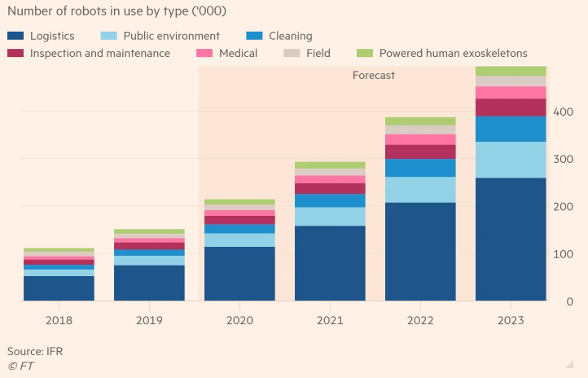
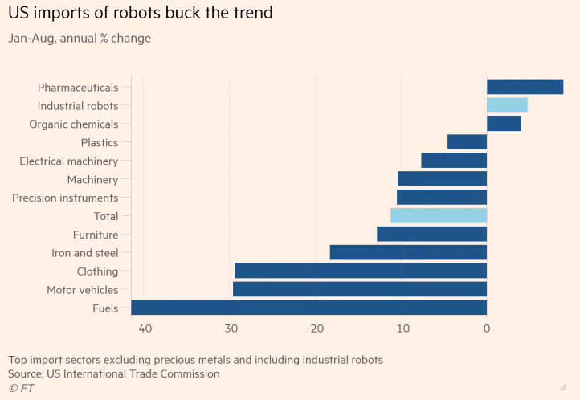
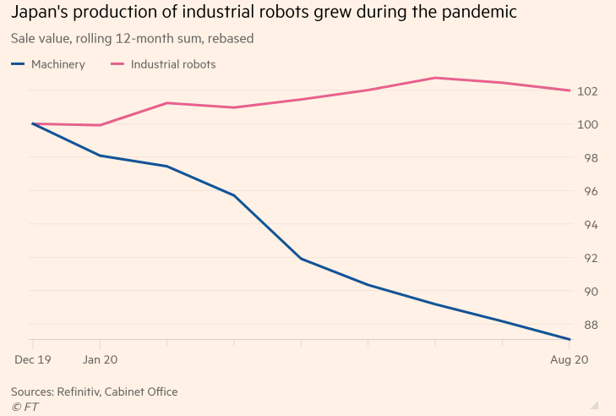
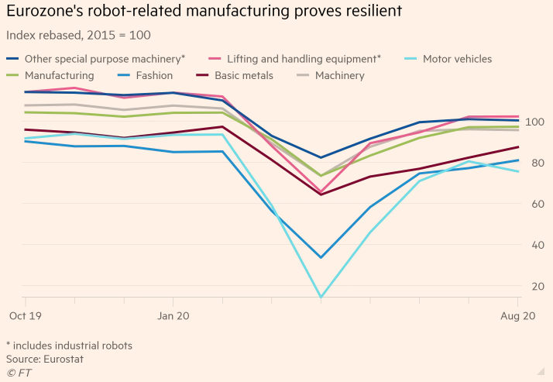
https://www.ft.com/content/358f6454-e9fd-47f3-a4b7-5f844668817f

Slide 15
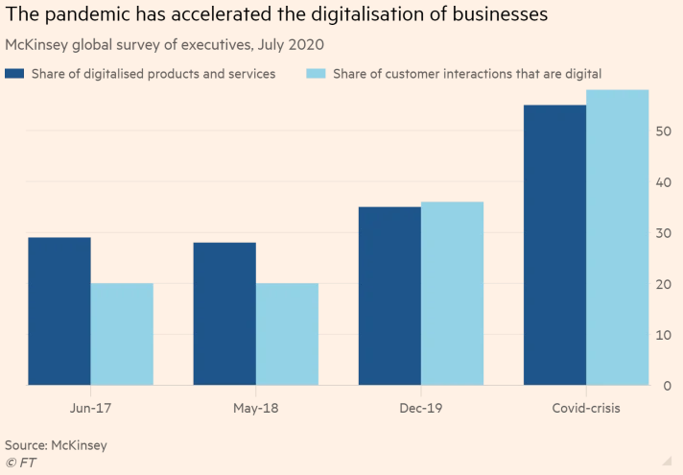
https://www.ft.com/content/358f6454-e9fd-47f3-a4b7-5f844668817f

Slide 16
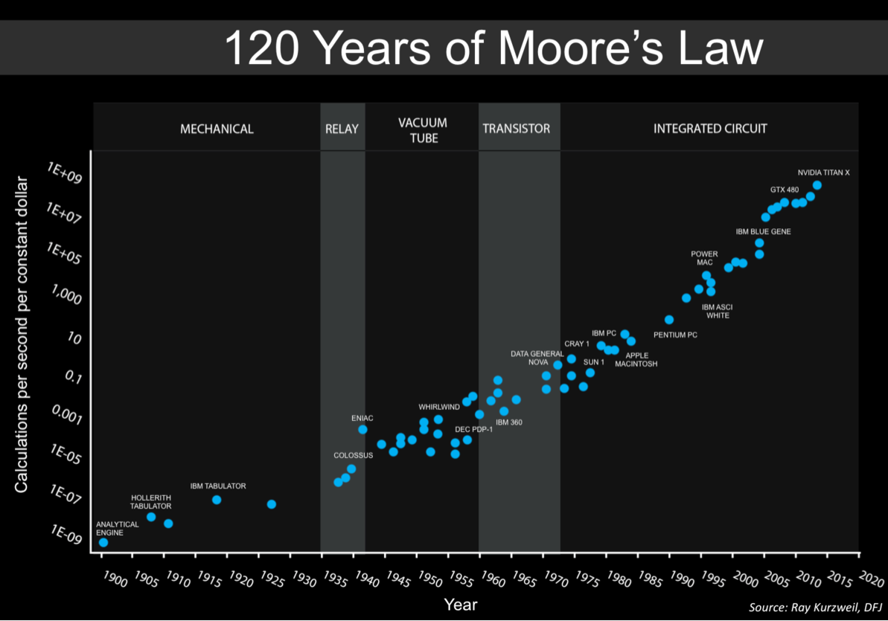
https://commons.wikimedia.org/wiki/File:Moore%27s_Law_over_120_Years.png
Notes:
Moore’s law (#processors double every 18 months) – same phenomenon happening in lots of technologies because analog devices become digital devices (e.g., first digital camera, 1.3 Megpixels, in 1991 was $13K; today there are two of them in your phone). Exceptions: batteries, machine learning
Over last 10 years, cost of:
Sensors has dropped 2X
Bandwith has dropped 40X
Processing has dropped 60X
Source: IDC

Slide 17
Digital Supply Networks and the Digital Capabilities Model: An Overview
Learning objectives:
  Appreciate the potential value creation that can come from digitalization
  Identify types of technologies enabling SC transformation
  Understand the underlying capabilities that digitalization can enable
  Understand the foundational and crucial role of data
Core concepts:
  Instrumented, Integrated (connected), Intelligent
  Always on, on-demand
  Transparent
  Sense, collaborate, optimize, respond (adaptive)
  From chains to networks
  Structured and unstructured data
Highlighted technologies:
  Decision support, processing (automation), communication, integration (platform)

Slide 18
Digital Capabilities Model (DCM)
Compare with other “digital supply chain” models e.g., Gartner (slides 24 and 25)
DCM content (see file: DSN Capability Model Release 2)
  Digital Disciplines: Sense, Collaborate, Optimize, Respond
  Six Level 1 capabilities; 38 Level 2 capabilities
    Definitions, examples, personas
    Positioning in process cycles (journey maps)
    Maturity levels
    KPIs

Slide 19
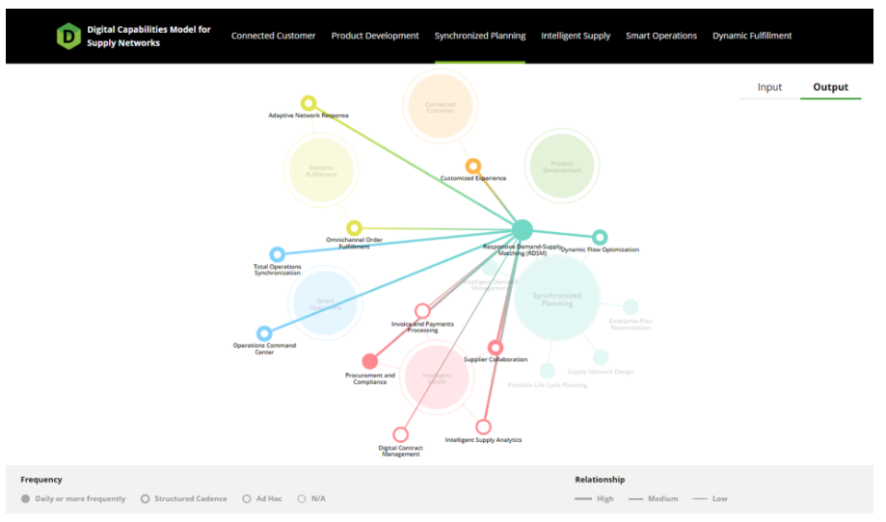
Digital Capabilities Model (DCM)
https://dcm.ascm.org/
Notes:
What was genesis
Next steps

Slide 20
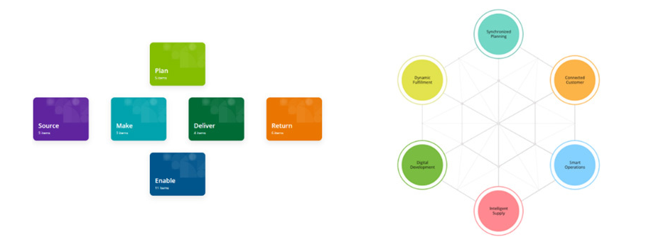
Comparing the DCM and SCOR
Notes:
What was genesis
Next steps

Slide 21
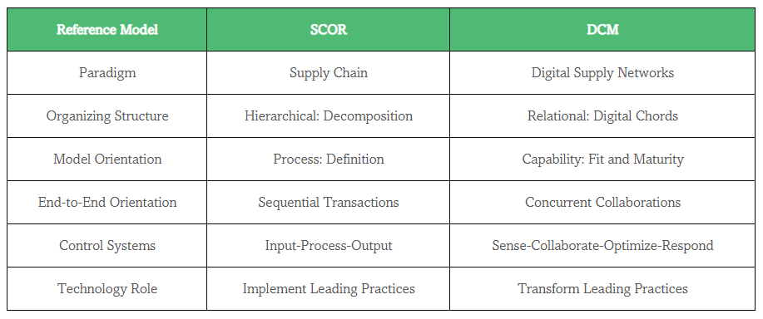
Comparing the DCM and SCOR
http://scnavigator.avnet.com/article/december-2020/new-capabilities-focused-reference-model-aims-to-accelerate-digital-supply-chain-transformations/

Slide 22





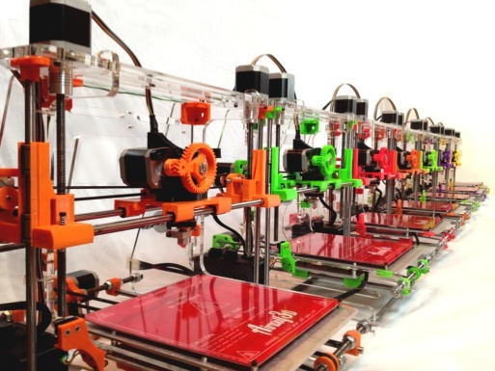

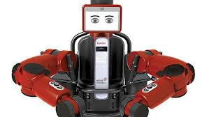




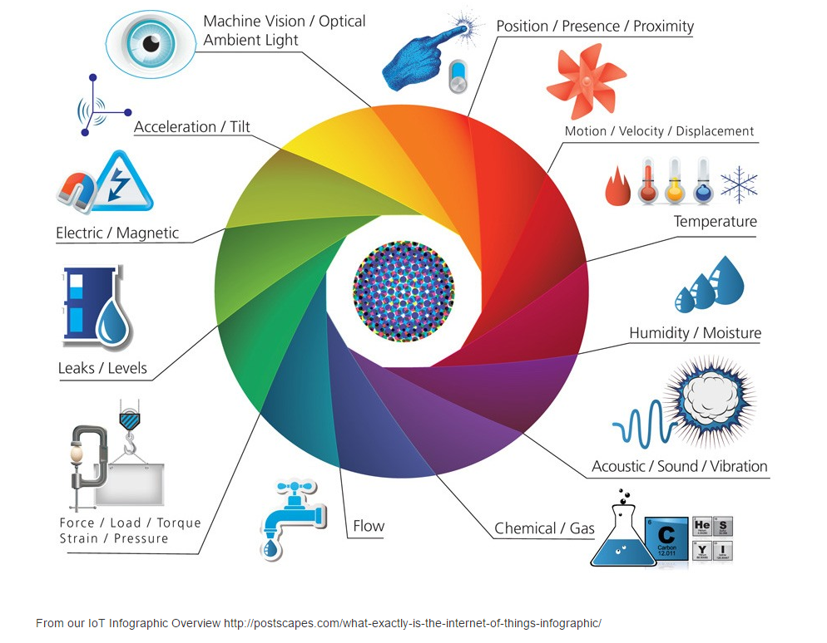



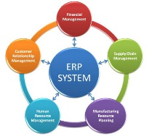

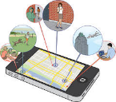
Enabling Technologies for the Digital Supply Chain
Type of Technology | Capabilities | Examples
Analytics/decision technologies | Provide data processing, computing power, and intelligence to make higher-quality decisions faster. | Advanced planning systems (APS) Network optimization Management and execution systems (TMS) (WMS) (MES) (YMS) (OMS) Analytics, AI, machine learning
Processing technologies | Automate transactions and material processing to provide 24/7 resource availability, faster processing, improved consistency, and lower cost. | Programs, software robots (RPA) Computer-aided design and machining, 3D printing Industrial robots, flexible manufacturing systems (FMS) Drones, autonomous vehicles and mobile robots (AMR) Automated storage/retrieval systems (AS/RS)
Communications technologies | Improve data capture and visibility (accuracy, currency, completeness, useful format) to provide access to rich information. | Sensors, scanners and radio frequency identification (RFID) Global positioning systems (GPS) The Internet, Wi-Fi, narrow band, cellular, microwave, radio, etc. Satellites, fiber optics, etc. Electronic data interchange (EDI), global data synch network (GSDN)
Integrative/platform technologies | Combine and host data and transaction management to provide communications, visibility, decision support, and processing capabilities. | Cloud computing and services/Blockchain Mobile apps, wearables, augmented/virtual reality (AR/VR) Enterprise resource planning (ERP), Product life cycle mgmt (PLM) Relationship management (CRM) (SRM) (CPFR)
Notes:
Overall trends:
Inside out – most focus has been on improving internal planning and transaction management (e.g., ERP, APS), just now turning to external visibility, connectivity, coordination
Foundations create greater options/opportunities – sensors and connectivity create visibility and data, which enable analytics, learning, and responsiveness
DSS (Automating and Augmenting Mind): Analysis
PT (Automating and Augmenting Body – muscle
s, senses): Transformations – automate transactions, physical transformations, transportation
CT (Automating and Augmenting Communication): Infrastructure, data capture and transmission – eyes, ears, voices
IT (Automating and Augmenting): Platforms – “spirit”
What other technologies are not represented here (missing)?

Slide 23
Technology landscape
Technologies | Connected Customer | Digital Development | Intelligent Supply | Synchronized Planning | Smart Operations | Dynamic Fulfillment
Decision support
Processing
Communica-tions
Integrative (platform)

Slide 24

Dimensions of Visibility
Timely
Formatted
Complete
Accurate
Demand
(Sales, Customers’ forecasts)
KPIs
(Cost, Service, Quality)
Inventory
(Location, Movements, Provenance)
Disruptions
(Weather, Earthquakes)
Processes/Capacity
(Utilization, Productivity, Yield)
Pipeline Threats
(Congestion, Labor actions)
Assets
(Location, Utilization, Status)
Markets
(Commodities, Capital)

Slide 25
Managing Digital Transformation
Learning objectives:
  Explain the basic elements of a comprehensive roadmap for DT
  Identify the key challenges with and inhibitors of DT
  Understand different organizational structures and approaches
  Appreciate the role of human capital in transformation efforts
Core concepts:
  Digital maturity
  Technology readiness

Slide 26
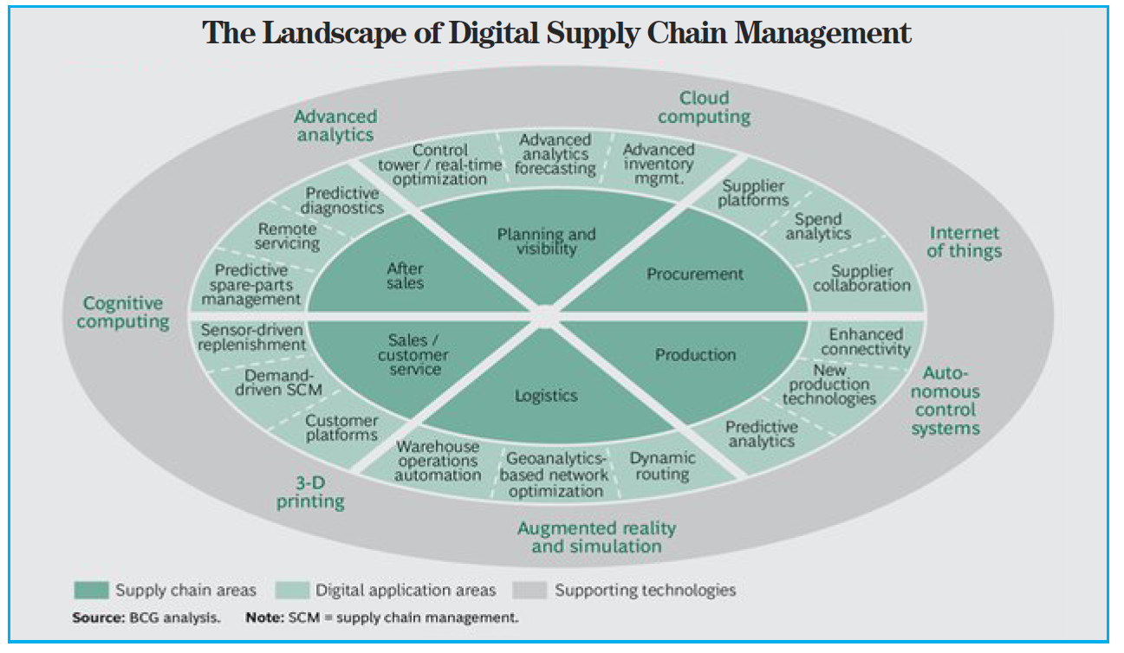
Digital Supply Chain Transformation
BCG PERSPECTIVES, February 1, 2016, “Three Paths to Advantage with Digital Supply Chain,” by Amit Ganeriwalla, Gideon Walter, Libor Kotlik, Robert Roesgen, and Stefan Gstettner.
https://www.bcgperspectives.com/content/articles/supply-chain-management-technology-digital-threepaths-advantage-digital-supply-chains/

Slide 27
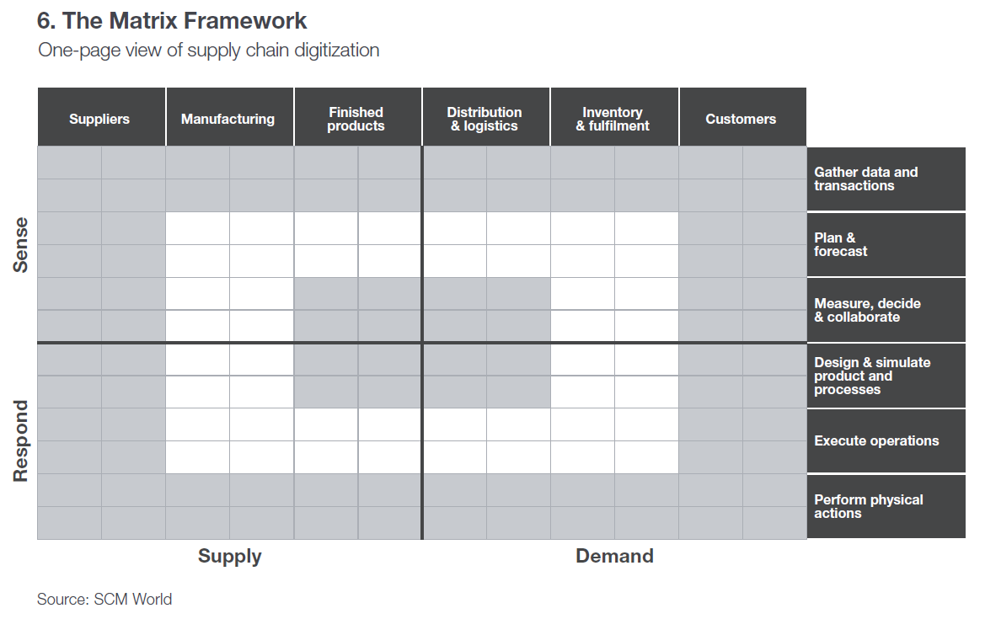

Slide 28
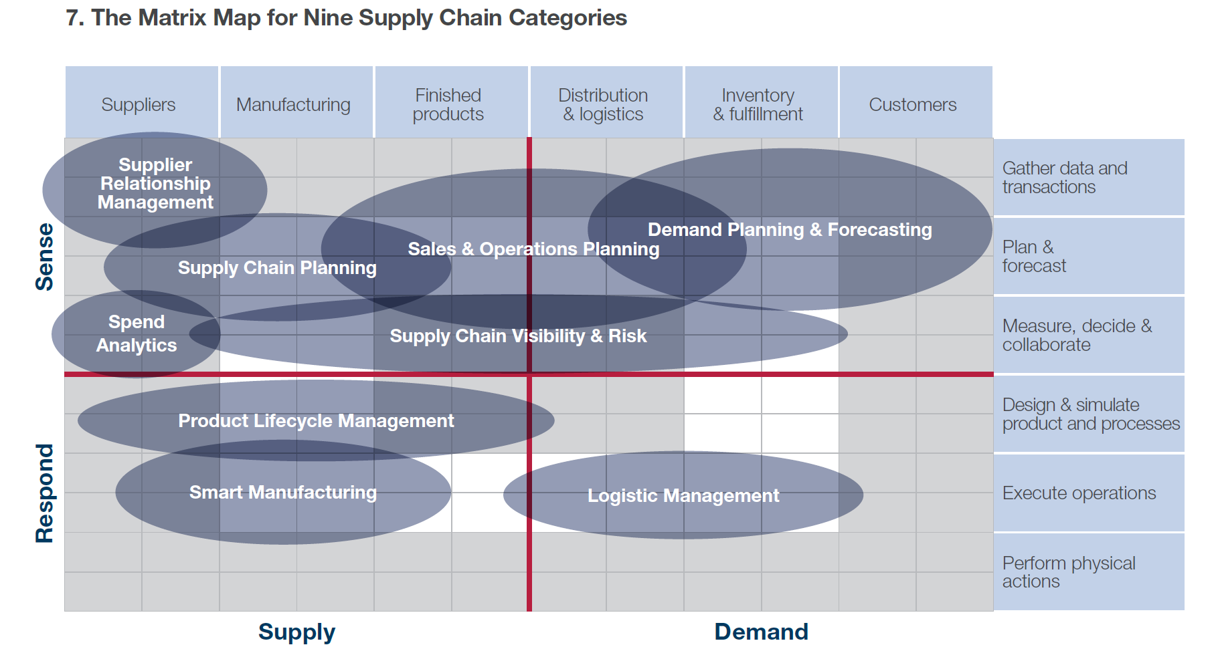
A Functional Perspective
Source: Gartner/SCM World

Slide 29
Digitized
Standardizing
Sensing
Capturing
Authenticating
Cleansing
Connected
Combining
Filtering
Structuring
Reporting
Alerting
Intelligent
Transacting
Visualizing
Diagnosing
Predicting
Prescribing
Adaptive
Adjusting
Reconfiguring
Matching
Giging
Orchestrating
Data
Information
Insight
Action
Inter/Intra Organizational Integration
Systems - Structure - Roles
Intellectual Capital
Talent - Knowledge - Skills
Notes:
1. Getting the right data in the right form at the right time (this is the current challenge for many/most firms)
2. Communicating data as useful information to the right stakeholders
3. Deriving actionable insights from the information
4. Adjusting operations quickly enough to capitalize on the insights
Visibility channels: demand (pos); capacity; inventory; assets (locations, utilization, operational status); process monitoring; disruptions/threats; KPIs (cost, service, quality)
- Standardizing: GS1 or other data capture and sharing protocols
- Sensing: from sensors, click data, POS, partner feeds, etc
- Reporting/filtering – overall data but also identifying “exceptions”
- Combining is “data integration” (e.g., combining customer and geocode data) and “data engineering“ - "the art and science of blending data from multiple (and different) sources, automatically cleaning and filtering the data, and transforming the data to be useful for analysis.“ (current, accurate, complete, useful format)
Analytics
- Structuring includes cleansing/validating integrity (e.g., deleting data that meet certain criteria, standardizing, etc.)
- Visualization includes description
- Cognifying usually involves machine learning
Responsiveness
Alerting – messaging about opportunities
Matching supply with demand
Automation: software agents as well as hardware
Giging – on demand capacity, configuring solutions from collectives and ecosystems
Coca Cola Co. is trying to put mobile commerce to work making its supply chain more efficient. Facing potential lost sales and distribution challenges for small retailers, the beverage giant is encouraging mom-and-pop stores to use a mobile app to replenish shelves with cans and cases on demand, the WSJ’s Kim S. Nash reports. Business-to-business apps modeled on consumer technology are inching into supplier-vendor relationships, and in this case Coca-Cola is extending the tactic to its logistics, promising a delivery time and then enlisting help from “gig” workers on motorbikes to handle the products. .
Flexing – response to anticipated changes with in given operational structure (configuration)
Agility” - response to unanticipated changes (resilience, reconfiguration)
Might improve reactiveness and flexibility greatly through uberization/crowd sourcing
“Robots as a service” – leasing flexible and autonomous robotics
Integration
Our research shows that firms rate the impact of visibility on responsiveness 5-6 times higher when they have high integration. At low levels of integration the impact of visibility is negligible
Intellectual capital
- Human capital – domain knowledge + data science skills
- Operates at three levels of planning/execution: Strategic, tactical, operational
Key enabling technologies: (where are these respectively on the PLC or diffusion curve?) all subject to Moore’s law growth/diffusion
IT (processing capability) + Internet (information ubiquity) + mobility (removing location as a constraint)
Sensors
Cloud
Machine learning/AI
Robotics/automation

Slide 30
Enabling Technologies (examples)
RPA, RAAS, 3D printing
On-demand, networked P2P processes
Adaptive
Execution systems (TMS, WMS)
DBMS, Analytics, AI/Machine Learning
Digital Maturity
Number of functions, capabilities,
and performance elements impacted
Intelligent
ERP, CRM, SRM, Dashboards, EDI/GDSN/IOS, Blockchain
Connected
Sensors (GPS, RFID), IoT, POS, Telematics Clickstreams/Feeds, Standards (GS1)
Digitized
Scope of Digital Transformation
Investments in technology and supporting changes
in organization structure and human capital

Slide 31
Accuracy, consistency, speed
Intelligence
Agility
AI/Machine learning
Autonomous Processes
Optimization
On-demand networks
Analytics apps
Control Towers
Monitoring Reporting Analyzing Prescribing
Blockchain
TMS, WMS,
OMS
Insight
Visibility
Efficiency
CRM, SRM
Dashboards
User apps
EDI
ERP
RPA
Scorecards
Availability, quality, customization
Alerts
AR/VR
POS
Robots / Cobots
RFID
GPS
Sensing Storing Structuring Deciding Acting
Automation

Slide 32
Accuracy, consistency, speed
Intelligence
Prediction/Forecasting
Recognition/Identifying
Diagnosis
Matching/Recommending
Translation
Monitoring/Control
Agility
Scalability
Shiftability
  Product mix
  Routing/processing
  Process robustness
Customization
Fast/lean launch
Digital Supply Chain Capabilities
Perspective
Monitoring Reporting Analyzing Prescribing
Insight
Visibility
Demand
Supply/Inventory
Process health
Capacity/utilization
Asset location/status
Markets
Disruptions/Threats
Efficiency
Productivity
Speed/Reliability
Quality/Accuracy
Availability
User experience
Availability, quality, customization
Sensing Storing Structuring Deciding Acting
Automation
Notes:
Lennox/ToolsGroup SO99+ – slow mover long tail demand items; high number of SKUs, very seasonal, expanded network (2.5X locations); 2015 SCIA finalist
Lennox uses machine learning and cluster analysis to recognize more than 200 “micro-climates” within the United States and their seasonal timing variations. Machine learning sifts through the SKU-Locations to identify “clusters” with similar seasonality profiles. Lennox improved service levels by 16% while simultaneously increasing inventory turns by 25%.
Reduction in inventory approaching 20%, despite a 250% increase in physical locations
Improved service levels by about 20%, with a roughly 15% increase in fill rate
Reduced distribution costs as a percentage of sales by more than 15%
Lennox's supply chain team achieved these dramatic improvements while expanding their supply chain network from two national distribution centers serving 66 retail stores to a hub-and-spoke model with nine regional centers that currently serve 170+ stores.
http://www.prnewswire.com/news-releases/cscmp-shortlists-lennox-industries-with-toolsgroup-for-prestigious-supply-chain-innovation-award-300145219.html
Increased inventory turnover by more than 20% since 2011
Reduced response time: improved the capability for same day delivery to 40%, and increased orders that can be delivered the next morning from 35% to 98%
Nike talked about its plan to speed up manufacturing during the company’s investor day yesterday (Oct. 25). Executives said that new products in the pipeline, more focus on e-commerce, tighter distribution through retail partners, and—of course—speed. One emphasis is near-shore production to serve North America. Nike makes most of its goods in Asia, but it has started bringing more manufacturing to regions such as Latin America, where it’s using automation to keep labor costs down and make products quickly.
Eric Sprunk, Nike’s chief operating officer, offered details about the company’s production and its two-year old partnership with Flex, a global manufacturer. Nike, he said, has just moved into a “near-shore, purpose-built footwear factory with Flex that will deliver over 3 million pairs to North America in fiscal year ’18 alone. By 2023, together with Flex, we plan to produce tens of millions of pairs near shore.” More than 25% of those shoes, he added, will be made on a “responsive model” with short lead times. In the past, Nike would start manufacturing when it got a futures order, meaning an order it had to deliver in the next six months. Now it’s moving toward manufacturing quickly in response to what consumers are actually buying. The relationship with Flex, Sprunk said, “allows us to take our standard time, from just manufacturing to market, from about 60 days to 10 days or less.”
Tens of millions is not the bulk of Nike’s manufacturing. For context, the company will ship 1.3 billion shoes in fiscal year 2018, it said. But it’s still significant.
The emphasis on speed isn’t limited to near-shore factories. By the end of the fiscal year, Nike will also have installed more than 1,200 new automated machines at the factories of its Asian suppliers to handle cutting, cementing, shoe assembly, and making soles. It’s innovating on processes, too, such as developing a faster way to make those labor-intensive sneaker soles.
The near-shore model reduces shipping expenses, import duties, and the risks of making a large volume of shoes in advance.
Adidas is counting on its Speedfactory in Germany and one opening shortly in Atlanta to do more of its own responsive manufacturing to serve European and US consumers. Sprunk appeared to take a shot at Adidas during his talk. “This is not about making one model in one factory,” he said, seeming to refer to the sneaker tailored to local markets Adidas is currently making at its Speedfactory. “For us, this is about scaling automation, digitization, and robotics across our entire source base and across our entire product line.”
In our industry, there is no way to make any abrupt, larger-scale short-term movements. You have a footprint, you have contracts, you have a supply base, you have capacity. Frank Witter, Volkswagen AG chief financial officer, on automotive supply chains.

Slide 33
Criteria for technology/solution selection
Functionality
  Scope of applications
  Unique functionality
Technology
  IT environment
  Forward looking technology
  Scalability/upgradability
  Integration/peripherals
Support from vendor
  On-site and telephone technical support
Process fit
  Industry specific solutions
  Supports business strategy
On-going maintenance
  Scope and fee structure
  Training, periodic review
Total cost of ownership
  One-time and recurrent

Slide 34
Connected Customer
Learning objectives:
  Review level 2 capabilities enabling connected customers
  Identify sources of data describing customers’ behaviors
  Describe various technology enabled methods for enhancing customer experience and insights
Core concepts:
  Customer engagement
  Evolved levels of “customer service”
Highlighted technologies:
  Apps and APIs
  POS systems
  Social media
  IoT in demand chain

Slide 35
Digital Development
Learning objectives:
  Review level 2 capabilities enabling digital development
  Understand the value of design-for-X technologies and processes
  Describe different platform-enabled business models
Core concepts:
  Platforms, modularity
  Co-development
Highlighted technologies:
  3D printing
  Virtual reality

Slide 36
Overview of Integrated PLM Components
Supporting info systems:
Product design and development
CRM
PDM
BOM
ERP(MRP)
SRM/SCM
CAD
CAE
Process design and development
SIM (CAPP)
SIM (VR)
Data conversion utilities
Interchange standards
Production execution
PLC
MES
CAM
Bill of Materials
Computer Aided Design
Computer Aided Engineering
Computer Aided Manufacturing
Customer Relationship Management
Enterprise Resource Planning
Manufacturing Execution System
Material Requirements Planning
Programmable Logic Controller
Product Data Management
Supplier Relationship Management
Simulation (Computer Aided Process Planning)
Simulation (Virtual Reality)

Slide 37
Intelligent Supply
Learning objectives:
  Review level 2 capabilities enabling intelligent supply
  Understand how digitalization enables intelligent and adaptive sourcing
  Describe how automation and connectivity improve procurement operations
  Examine technology-enabled risk detection and mitigation capabilities
Core concepts:
  Visibility and transparency
  Supply risk
Highlighted technologies:
  EDI
  GIS, alert systems

Slide 38
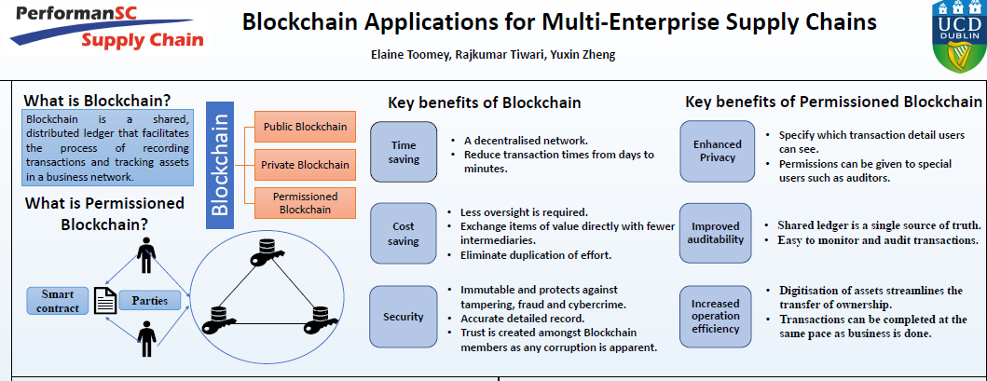

Slide 39
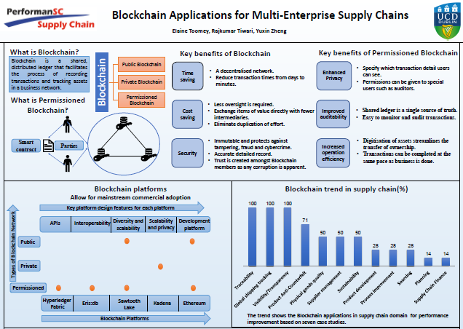

Slide 40
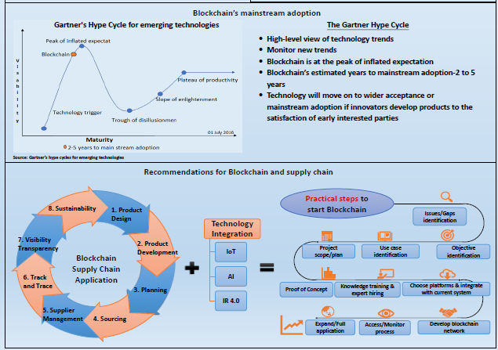

Slide 41
Synchronized Planning
Learning objectives:
  Review level 2 capabilities enabling synchronized planning
  Differentiate between strategic, tactical, and operational planning objectives and time frames
  Understand the challenges of developing accurate, complete, current, usefully formatted data to support planning
  Explain how data capture and processing technologies can be used to synchronize and optimize planning
Core concepts:
  Concurrent planning
  Digital twin, control towers, etc.
Highlighted technologies:
  Blockchain
  Cloud computing
  IoT in supply chain
  AI/Machine learning
Notes:
Should visibility, track and trace, etc. be addressed here?
Demand planning, capacity planning, materials planning……

Slide 42
Smart Operations
Learning objectives:
  Review level 2 capabilities enabling smart operations
  Understand the pros and cons of process automation
Core concepts:
  On-demand production
Highlighted technologies:
  Additive manufacturing
  Process monitoring

Slide 43
Dynamic Fulfillment
Learning objectives:
  Review level 2 capabilities enabling dynamic fulfillment and support
  Describe evolving fulfillment expectations and modes
  Examine alternative technology-enabled models for after sales support
Core concepts:
  Fulfillment centers versus distribution centers
  Amazon effect, last mile
  Omni-channel
Highlighted technologies:
  Warehouse automation (robots, drones, conveyances)
  Transportation automation (drones, automated vehicles, augmented reality)
  On-demand (gig) capacity apps

Slide 44
Course Conclusion: Visualizing the Future
Learning objectives:
  Review key learnings and frameworks
  Develop a vision for digital supply networks today, tomorrow, and in 2050
Core concepts:
Highlighted technologies:
  Nano-tech
  Augmented humans
  Virtual personal assistants (on-line identities)
  Advanced AI
  Supply Chain as a Service (SCaaS)

Slide 45
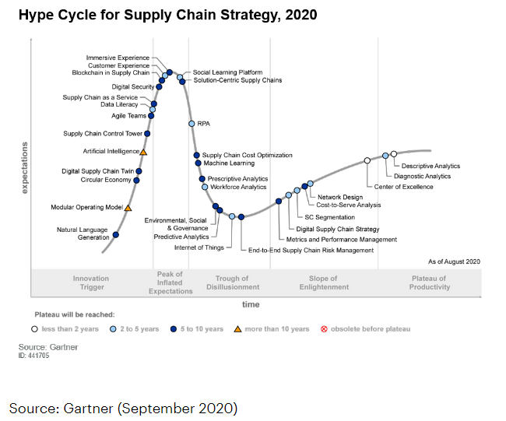

Slide 46
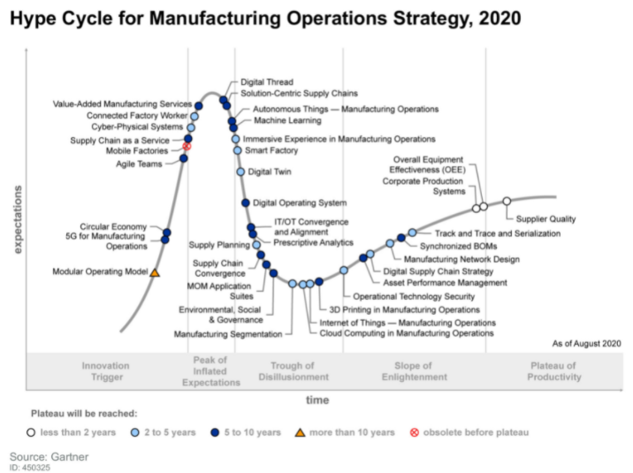

Slide 47
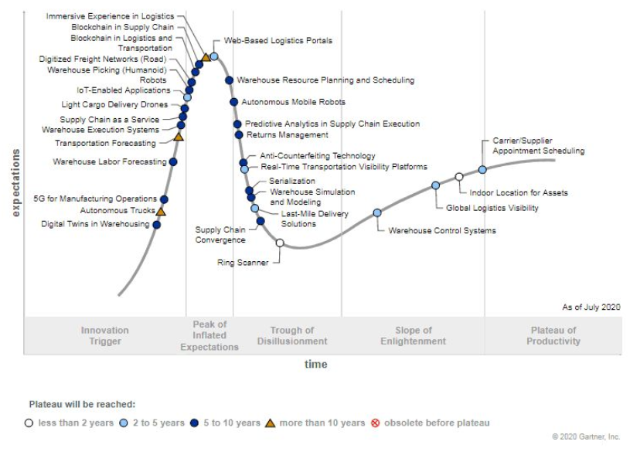
Hype Cycle for Supply Chain Execution Systems

Slide 48
